Slide 1
Voice Biometrices-SBI

Slide 2
Problem Being Solved
Recent data on mobile phone users all over theworld, the number of telephone landlines in operation, and recent VoIP (Voice over IP networks) deployments,confirm that voice is the most accessible biometric trait as no extra acquisition device or transmission system is needed.
This fact gives voice an overwhelming advantage over other biometric traits, especially when remote users or systems are taken into account.
However, the voice trait is not only related with personal characteristics, but also with many environmental and sociolinguistic variables, as voice generation is the result of an extremely complex process.

Slide 3
Thus, the transmitted voice will embed a degraded version of speaker specificities and will be influenced by many contextual variables that are difficult to deal with.
Fortunately, state-of-the-art technologies and applications are presently able to compensate for all those sources of variability allowing for efficient and reliable value-added applications that enable remote authentication or voice detection based just in telephone-transmitted voice signals.

Slide 4
Approach taken to create the model
Due to the pervasiveness of voice signals, the range of possible applications of voice biometrics is wider than for other usual biometric traits.
We can distinguish three major types of applications which take advantage of the biometric information present in the speech signal:
Voice authentication (access control, typically remote by phone) and background recognition (natural voice checking).
Speaker detection (e.g. blacklisting detection in call centers or wiretapping and surveillance), also known as speaker spotting.
Forensic speaker recognition (use of the voice as evidence in courts of law or as intelligence in police investigations).

Slide 5
Technology
The main source of information encoded in the voice signal is undoubtedly
the linguistic content.
For that reason it is not surprising that depending on how the linguistic content is used or controlled, we can distinguish two very different types of speaker recognition technologies with different potential applications.
Firstly, text-dependent technologies, where the user is required to utter a specific key-phrase (e.g., “Open, Sesame”) or sequence (e.g., “12-34-56”), have been the major subject of biometric access control and voice authentication applications.
The security level of password based systems can then be enhanced by requiring knowledge of the password, and also requiring the true owner of the password to utter it.
In order to avoid possible theft recordings of true passwords, text-dependent systems can be enhanced to ask for random prompts, unexpected to the caller, which cannot be easily fabricated by an impostor.

Slide 6
All the technological details related with text-dependent speaker recognition and applications are addressed.
The second type of speaker recognition technologies are those known as
text-independent.
They are the driving factor of the remaining two types of applications, namely speaker detection and forensic speaker recognition.
Since the linguistic content is the main source of information encoded in the speech,text-independency has been a major challenge and the main subject of research of the speaker recognition community in the last two decades.
The NIST SRE (Speaker Recognition Evaluations) conducted yearly since 1996 have fostered excellence in research in this area.

Slide 7
with extraordinary progress obtained year by year based in blind evaluation with common databases and protocols, and very specially the sharing of information among participants in the follow-up workshop after each evaluation.
Text-independent systems, including technological details and applications.
The second type of speaker recognition technologies are those known as text-independent.
They are the driving factor of the remaining two types of applications, namely speaker detection and forensic speaker recognition.

Slide 8
Since the linguistic content is the main source of information encoded in the speech,text-independency has been a major challenge and the main subject of research of the speaker recognition community in the last two decades.
The NIST SRE (Speaker Recognition Evaluations) conducted yearly since 1996 have fostered excellence in research in this area,with extraordinary progress obtained year by year based in blind evaluation with common databases and protocols, and very specially the sharing of information among participants in the follow-up workshop after each evaluation.
Text-independent systems,including technological details and applications,

Slide 9
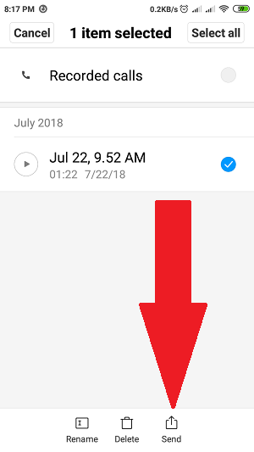
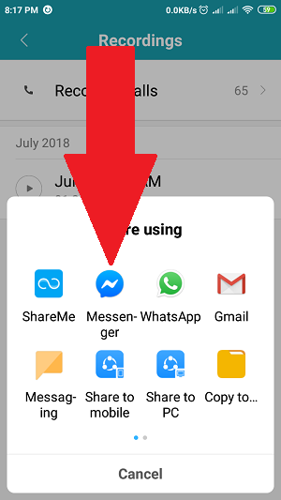
Length of voice clip
This is what I do when I want to send a voice recording that is longer than 1 minute on Facebook messenger.
First of all, I go to my default sound recorder app on my phone and record what I want to say to this person. It could be longer than 2 minutes.Later, long press the voice note and click send.
Tap the messenger icon to send the voice note on the app

Slide 10
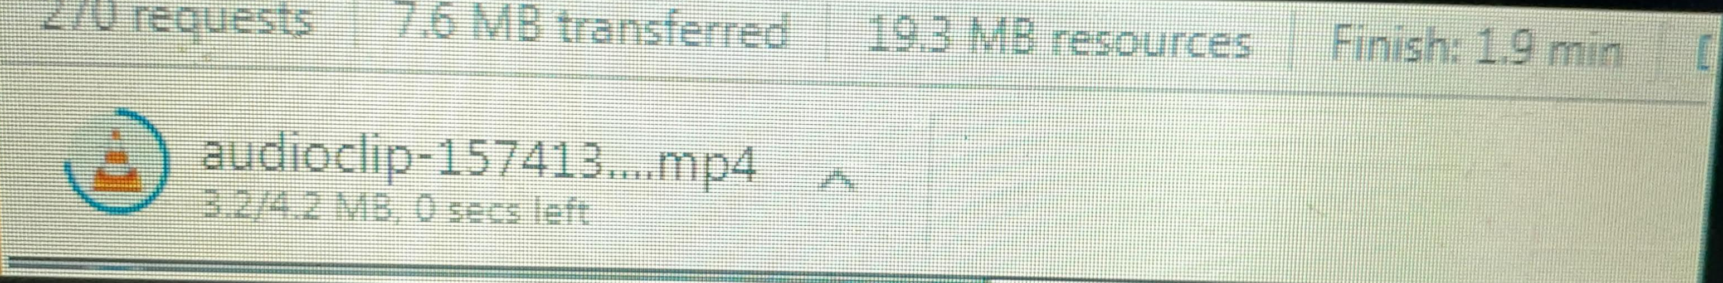
Sample of audio clip

Slide 11
Functional requirements(FR)
Functional requirement will describe a particular behavior of function of the system when certain conditions are met, for example: “Send email when a new customer signs up” or “Open a new account”.A functional requirement for an everyday object like a cup would be: “ability to contain tea or coffee without leaking”
Some of the more typical functional requirements include:
Business Rules
Transaction corrections, adjustments and cancellations
Administrative functions
Authentication
Authorization levels
Audit Tracking
External Interfaces
Certification Requirements

Slide 12
Non-functional requirements(NFR)
Non-functional requirement will describe how a system should behave and what limits there are on its functionality.
Non-functional requirements cover all the remaining requirements which are not covered by the functional requirements. They specify criteria that judge the operation of a system, rather than specific behaviours, for example: “Modified data in a database should be updated for all users accessing it within 2 seconds.”
A non-functional requirement for the cup mentioned previously would be: “contain hot liquid without heating up to more than 45C”.
Even in the case when the non-functional requirements are not met the basic functionality will not be impacted.
Non-functional requirements when defined and executed well will help to make the system easy to use and enhance the performance.

Slide 13
THANK YOU
Submitted by :Kuruguntla Tanuja
Email:180040698ece@gmail.com
Mobile no:7731023579

